Slide 1
RBE/CS 549 - Project 4
Deep Visual-Inertial Odometry
Team:
Thanikai Adhithiyan Shanmugam
Niranjan Kumar Ilampooranan
Notes:
This PowerPoint Template includes a series of slide masters with predefined layouts and color schemes for formatting slides
Slide Masters are displayed when you right click on a slide and select Layout from menu

Slide 2
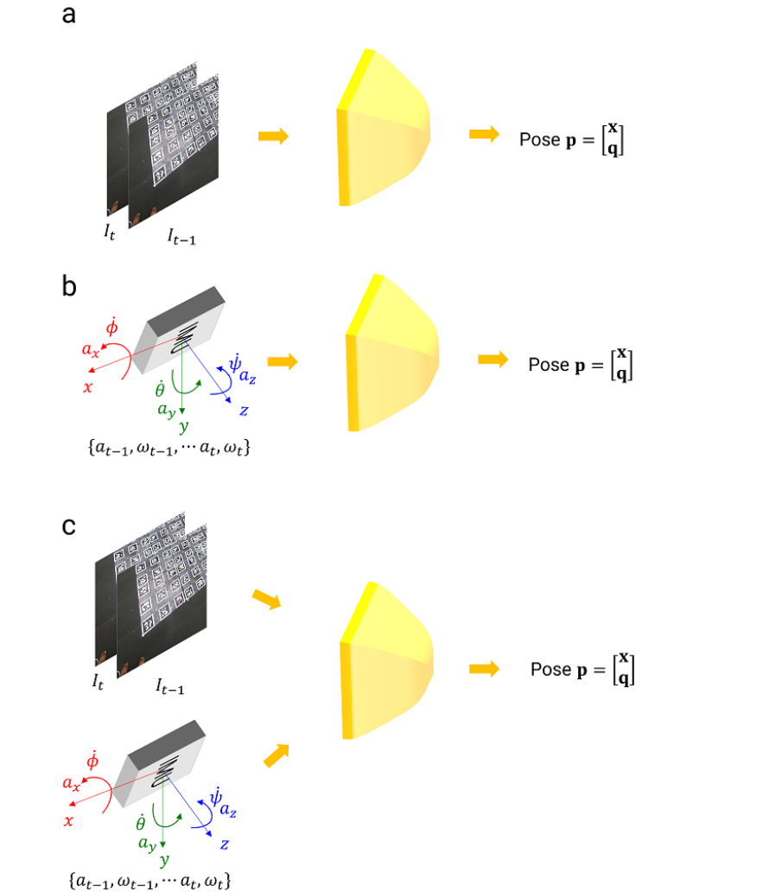
Introduction
Multi-Constraint Kalman Filter - means of solving the VIO (Visual-Inertial Odometry) problem
Implemented in Phase 1
Satisfactory results - RMSE ATE between ground truth and estimates
heavy dependency on feature detection and tracking
Can we use deep feature tracking?
Pretty straightforward for visual
But for IMU data?
Scarcity in deep learning methods in literature for VIO
We propose networks trained on synthetic data
To estimate odometry given the visual and inertial data
Picture courtesy: PeAR WPI lab

Slide 3
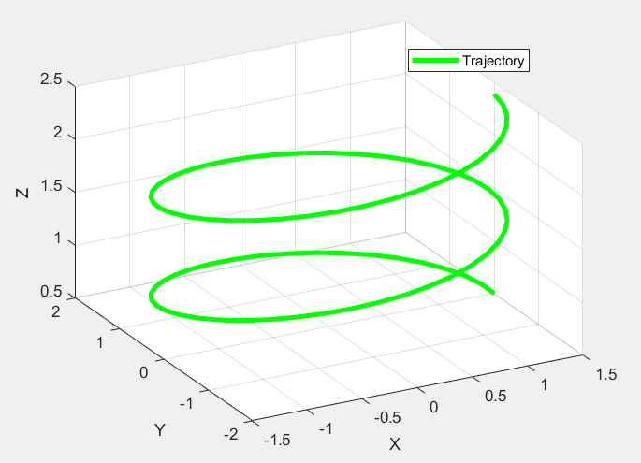
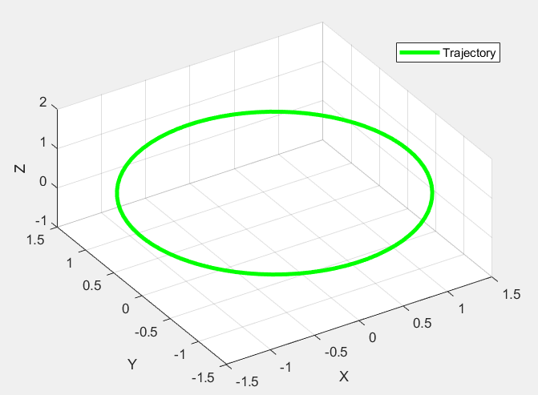
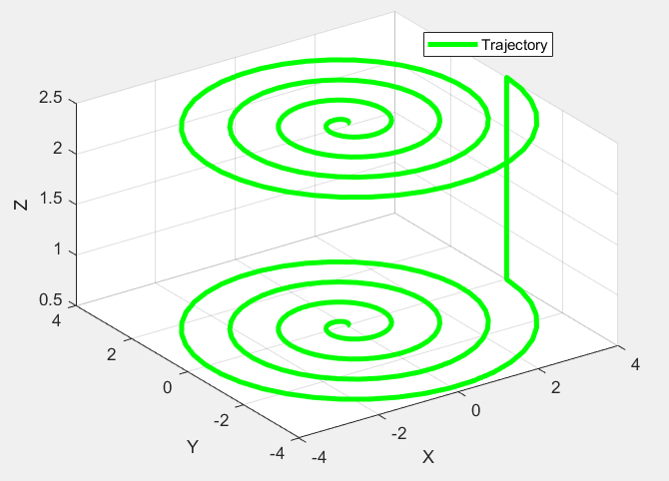
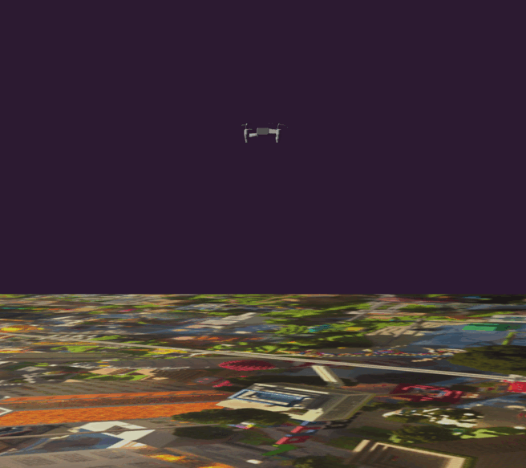
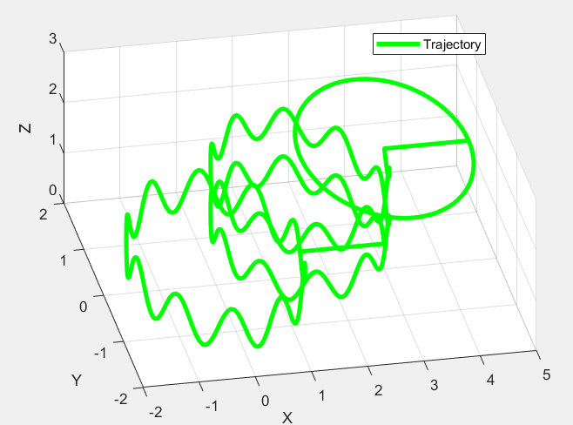
Dataset
Image generated from scene renders in Blender
No motion blurs, adequate realistic motion profiles
Input trajectories given to camera model
Trained on 7, tested on 1
Ground plane - rich in image features

Slide 4
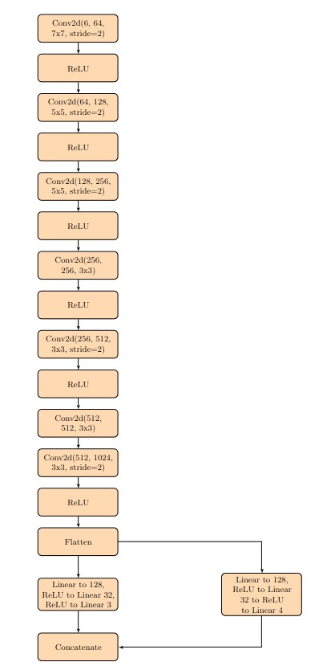
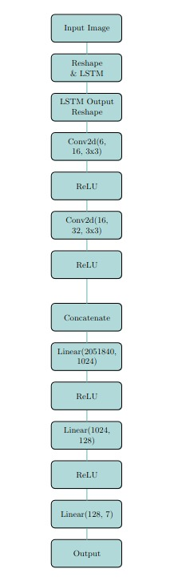
Network Architectures
Left - VO CNN
Right - VO LSTM
Estimate odometry using only visual features
Comparison performed between both

Slide 5
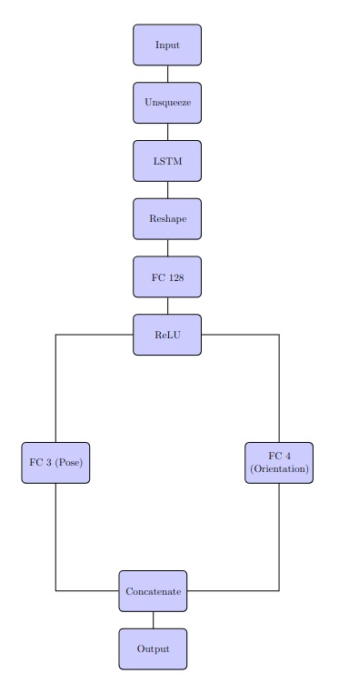
Network Architectures
IO network - uses inertial data to estimate odometry

Slide 6
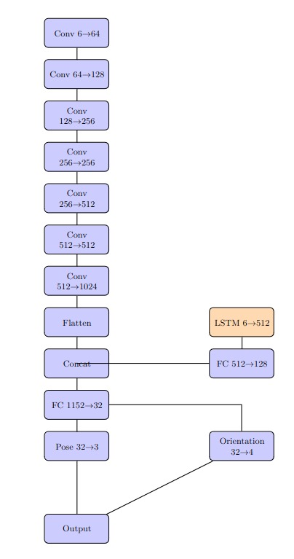
Network Architectures
VIO network - uses both visual and inertial data to estimate relative poses between frames

Slide 7
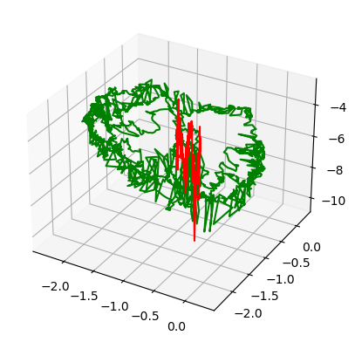
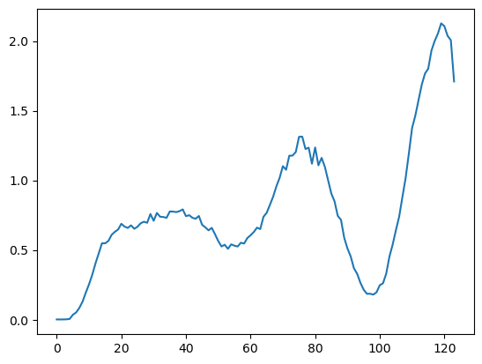
Visual Odometry Results

Slide 8
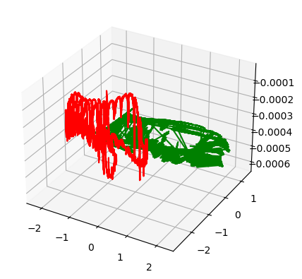
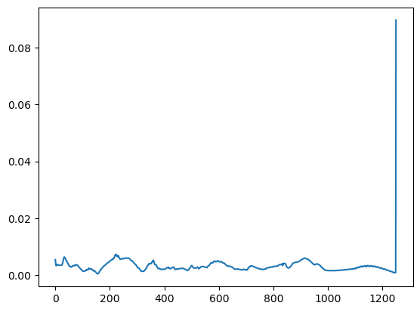
Inertial Odometry Results

Slide 9
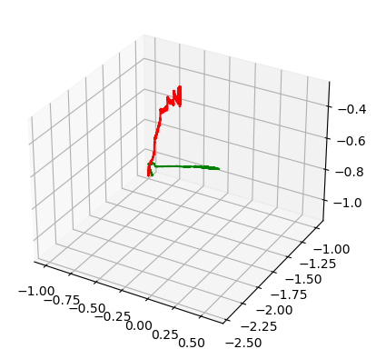
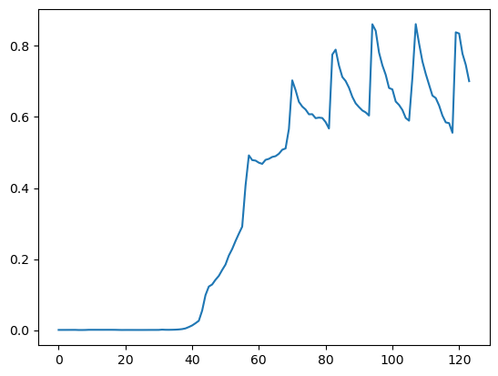
Visual Inertial Odometry

Slide 10
Thank You

